Slide 1
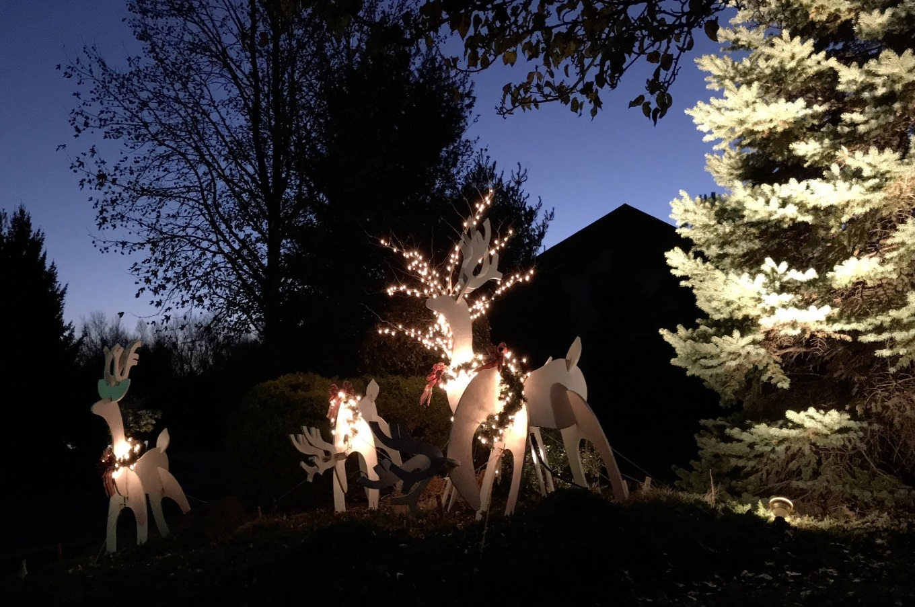
Yardley Village Budget Meeting for 2023 Budget (Via Zoom) December 7, 2022
Welcome

Slide 2
Agenda
2022 Expense Highlights
2022 Oct Fund Balances
2022 Forecast vs Budget
2023 Approved Budget
Your Capital Reserve
Questions

Slide 3
2022 Expense Highlights
Tree Trimming & Removal
Landscape Enhancements
Gutter Cleaning over forecast
Some sewer repairs (Capital)
Annual Capital Expenses under forecast

Slide 4
2022 October 31 Fund Balances
Operating Fund $ 128,104 (Note: Transfer of $40,000 borrowed from Capital pending)
Replacement Reserve Fund $1,915,683 using Cost Basics

Slide 5
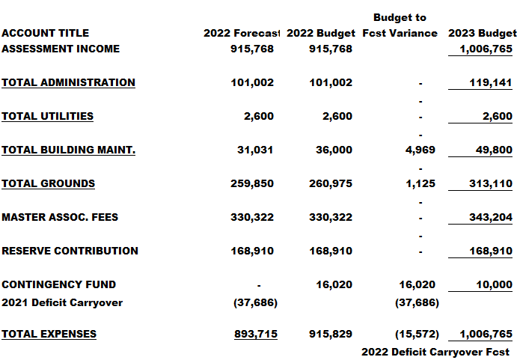
2022 Forecast vs Budget

Slide 6
2023 Operating Budget
Yardley’s Quarterly Assessment is still lower than many in HM

Slide 7
2023 Qtrly Assessment Changes
$165 Quarterly Assessment Increase (9.9%)
$ 23 Master Association Fees
$ 25 HM Landscape Services
$ 33 Insurance Increase
$ 11 Snow Removal (new 5 yr. contract)
$ 72 One Time Operating Expense Projects (Trees $12K, Clean Siding $13K, Road Sealing $14K)
$ 5 Misc. Landscape Improvements
$ 11 Misc. Other Increases
$-15 Misc. Reductions

Slide 8
2023 Budget (Fixed)

Slide 9
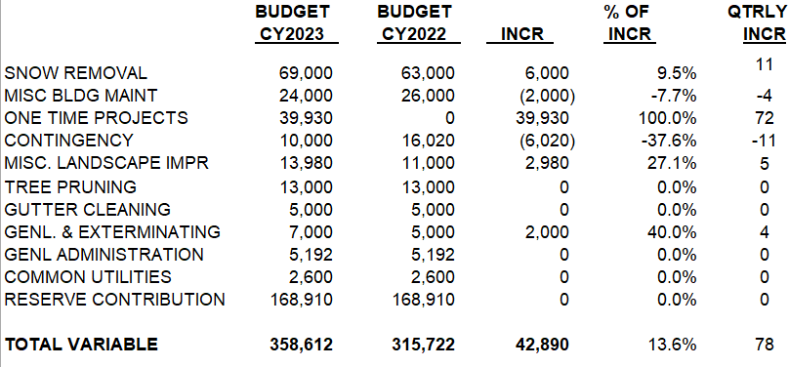
2023 Budget (Variable)

Slide 10
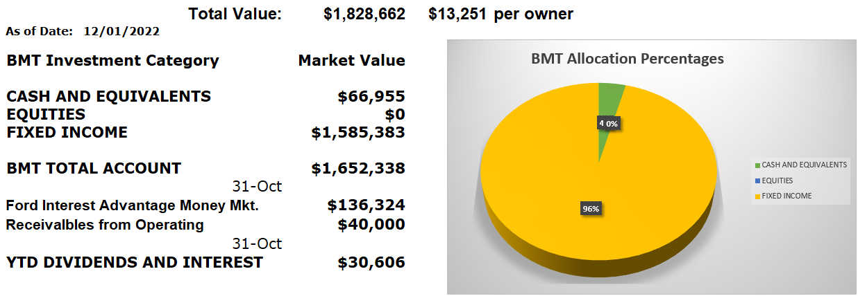
Your Capital Reserve Savings fund for Roofs. Roads, etc.
Note: Next major capital expenditures are planned for Roofing and 2 years later for Asphalt Paving.

Slide 11
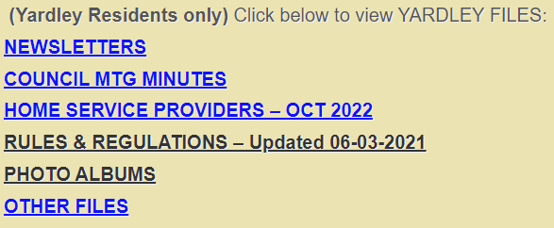
Questions
Our Rules & Regulations can now be accessed on the Yardley web page at:
www.yardleyvillage.com, scroll to bottom of page and click on "RULES & REGULATIONS"
Visit our Web Pages at: yardleyvillage.com
Updated

Slide 12
Header
New
New

