Slide 1
Emergent/Urgent Care Campaign
Michael Kallay, MD & Gary Fescine

Slide 2
Introduction
History
Common Sense

Slide 3
Director of Security - Hershey’s Mill
Marc Fraser
Tales of First Responders
Identify the problem

Slide 4
AFC Urgent Care
Amanda Furiato

Slide 5
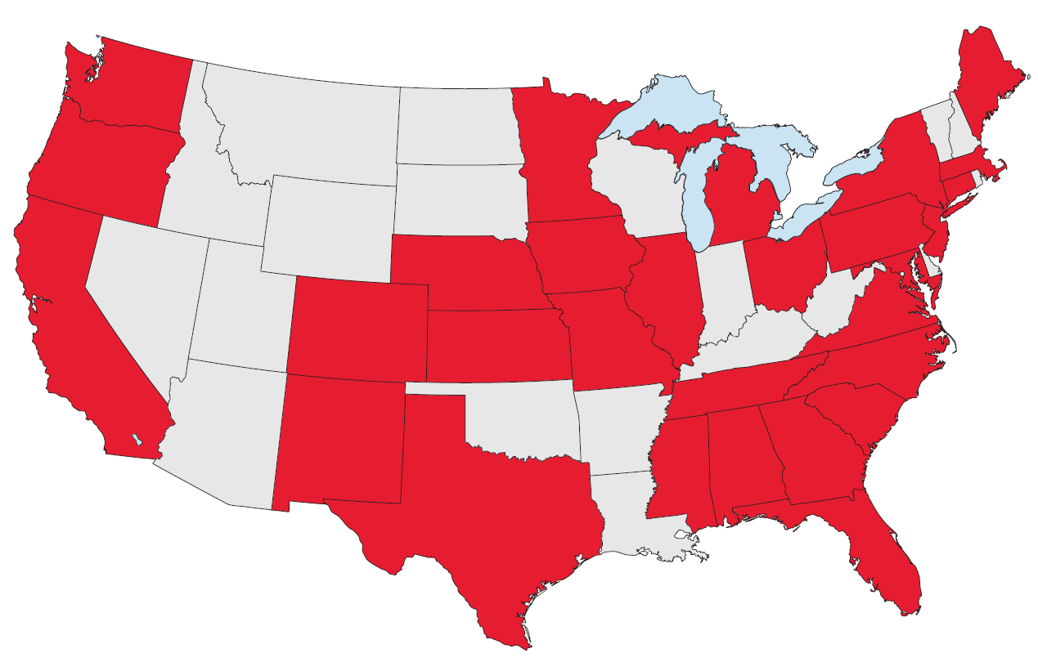
Welcome to afc!
MISSION STATEMENT
“Our mission is to provide the best healthcare possible, in a kind and caring environment, while respecting the rights of all patients, in an economical manner, at times and locations convenient to the patient.”

Slide 6
AFC vs. Emergency room
When do I use Urgent Care?
Urgent care centers are open 7 days a week for extended hours each day. AFC is open when you cannot get an appointment with your PCP or his/her office is closed.
AFC will treat non-life threatening illnesses and injuries at a much lower cost to you.
A visit to AFC will have you home and resting well before a visit to the ER.
WHEN TO GO TO URGENT CARE
Upper respiratory infections
Seasonal allergies
Sore throat
Urinary tract infections
Sprains & strains
Minor fractures
Wounds & lacerations
Migraine
Fever
Ear pain
Eye irritation
Body aches & pains
COVID-19 testing
Blood work
Same-day tests
EKG & X-Ray

Slide 7
Participating Insurances
We accept most major insurance carriers including Medicare.
For more information check out the afc table.

Slide 8
How can we Help our First Responders? How can we Help Ourselves?
Providing them with essential information about our health, hospital, emergency contacts, and physicians.
Princeton Village has put together a packet of Emergent care documents and relevant speakers
AGENDA
1) One -page Medical form
2) Penn Dot Yellow Dot Program
3) Medical ID on Smartphone/Android
4) POLST form

Slide 9
Topic one
Home Logistics –Yellow Dot Envelope and Refrigerator
A one-page medical form that includes emergency contacts, physicians,
chronic medical problems, medications, allergies, and recent surgeries.

Slide 10
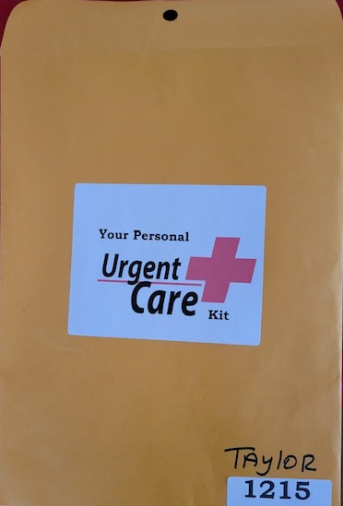

Slide 11
Envelope

Slide 12
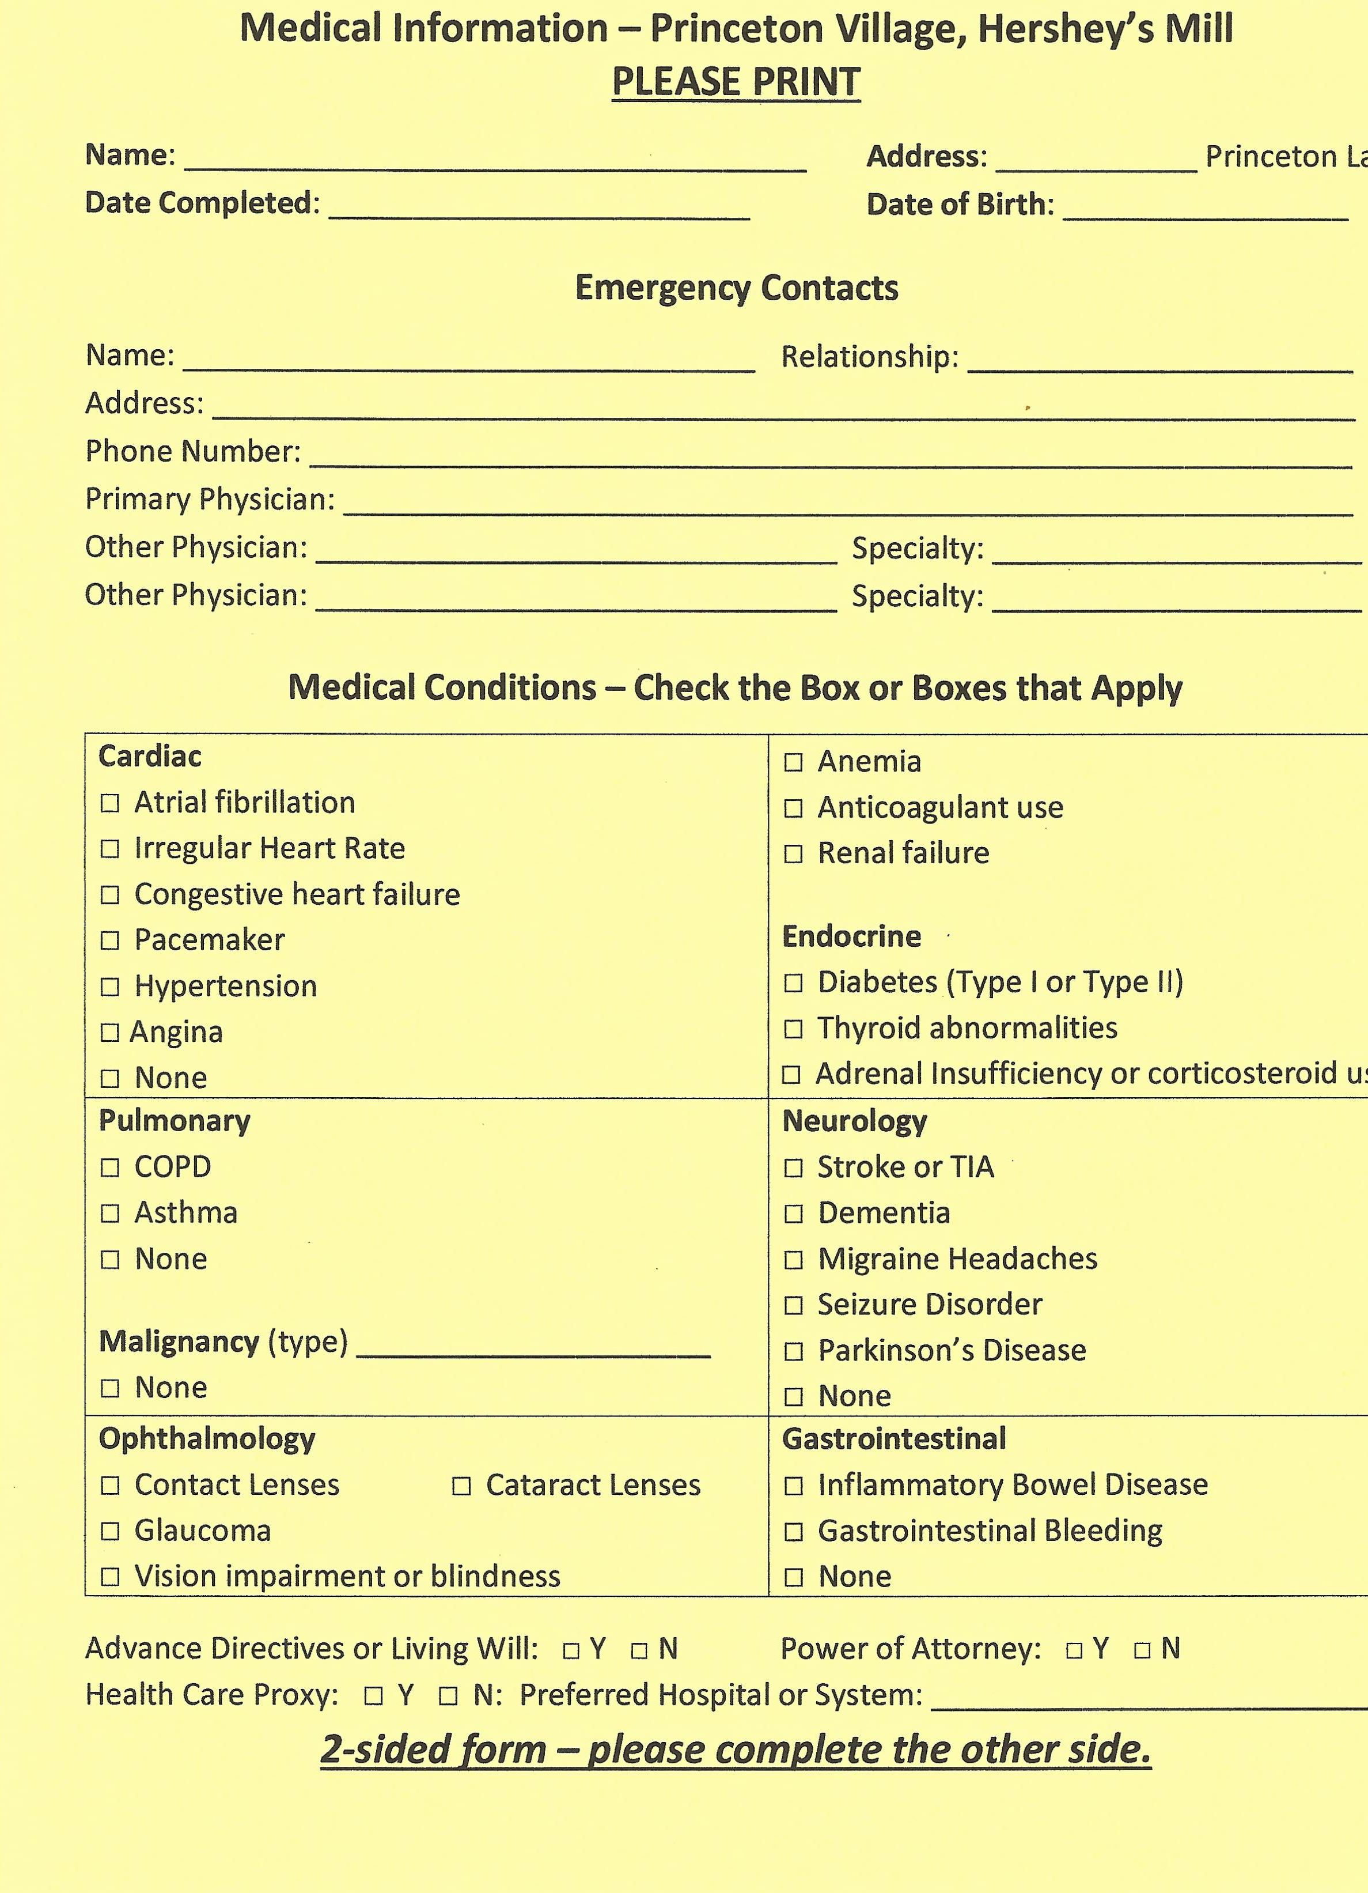
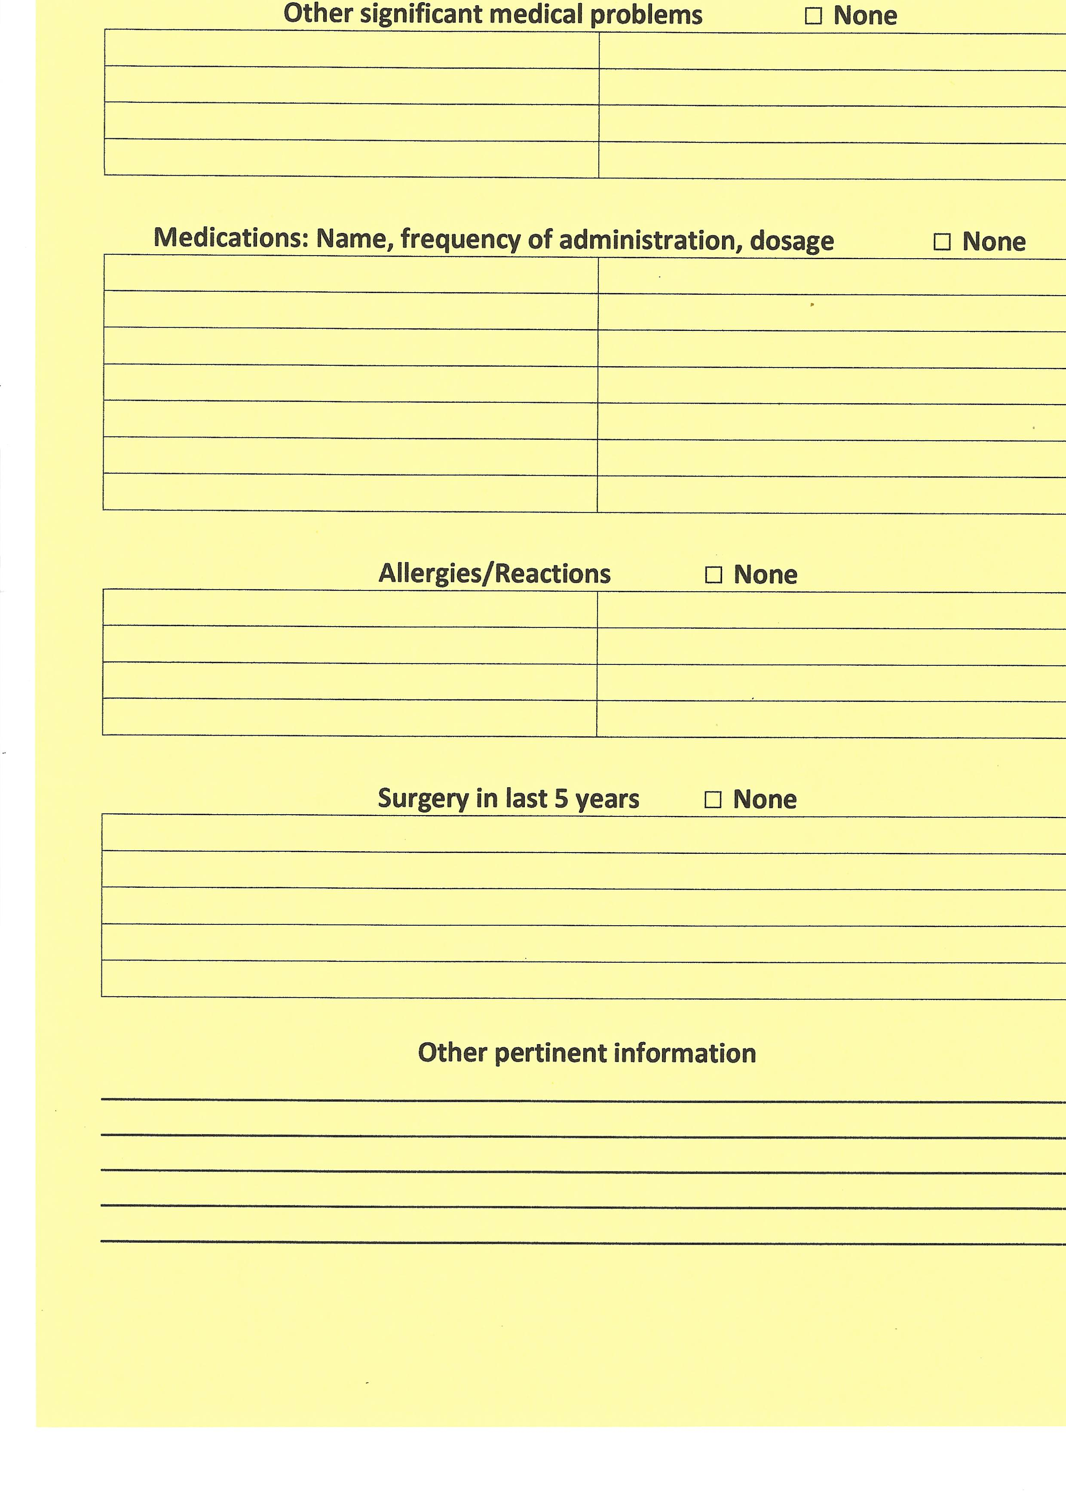
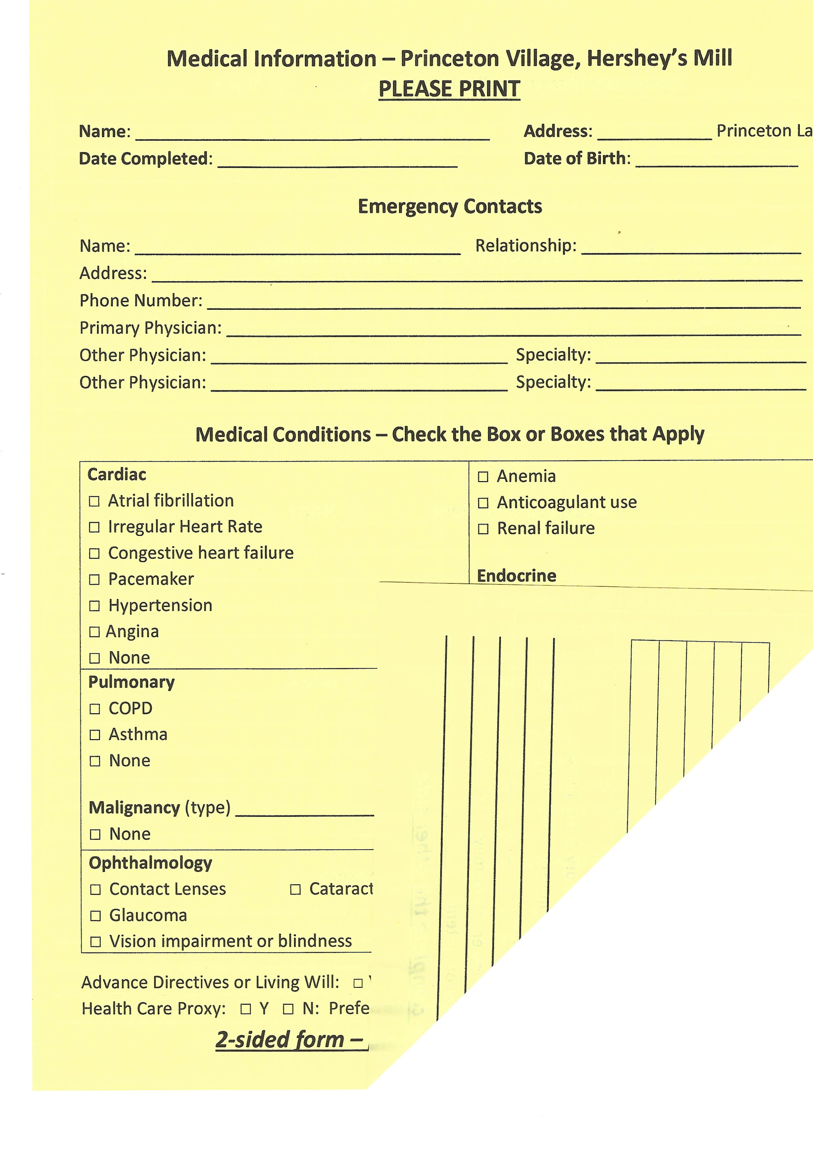
Medical Information Yellow Form
2-sided form

Slide 13
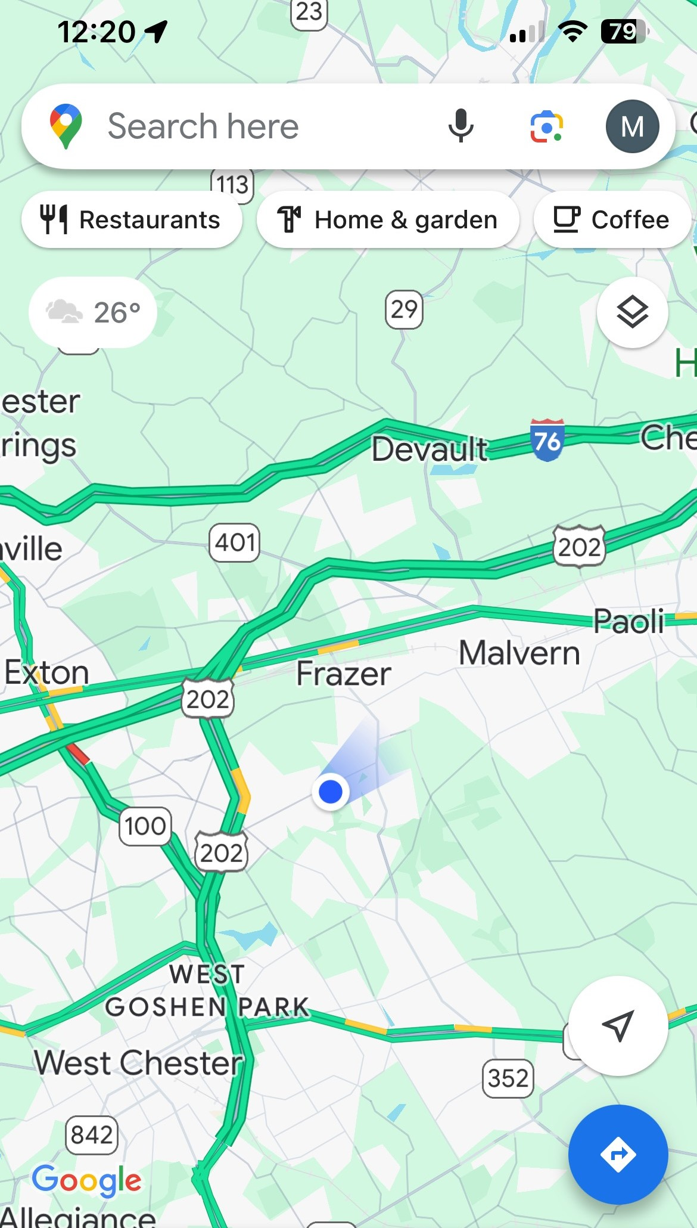
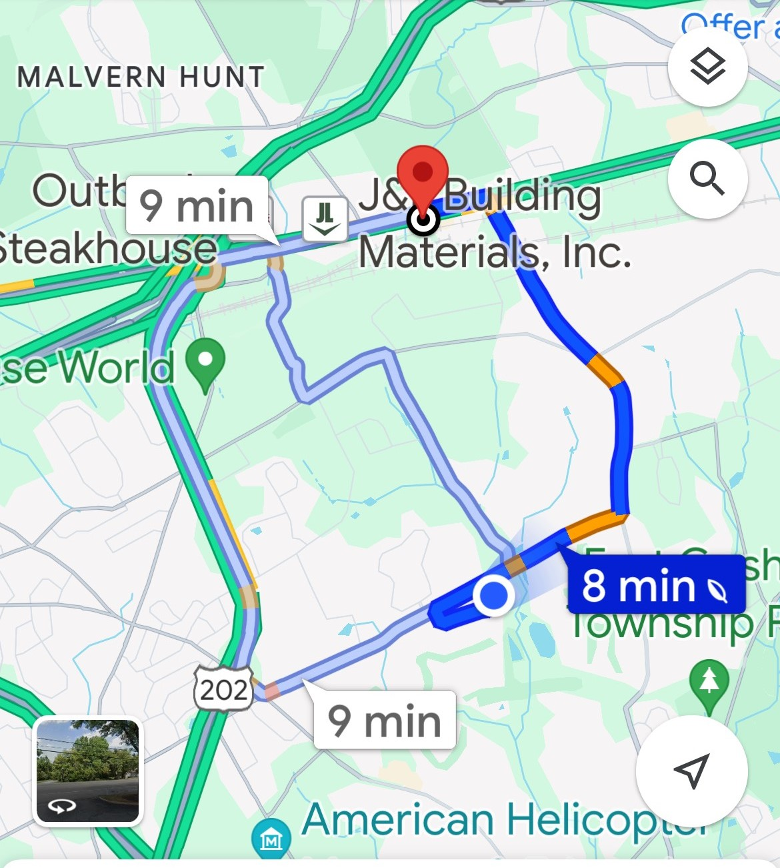
Navigating the EMR
Navigating the EMR with help of the Urgent care form

Slide 14
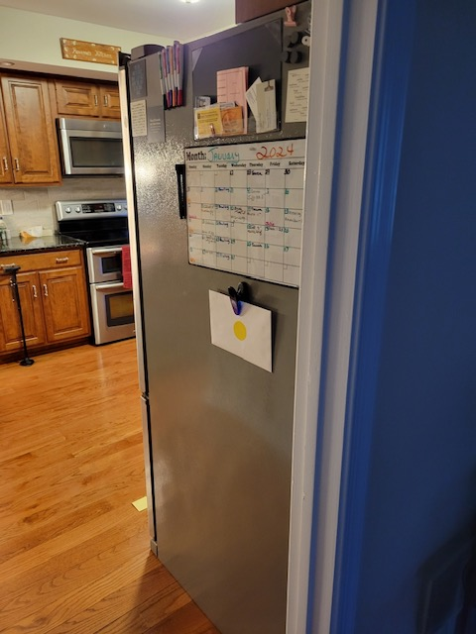

Slide 15
Topic Two
Penn Dot Yellow Dot Program
Automobile Logistics

Slide 16
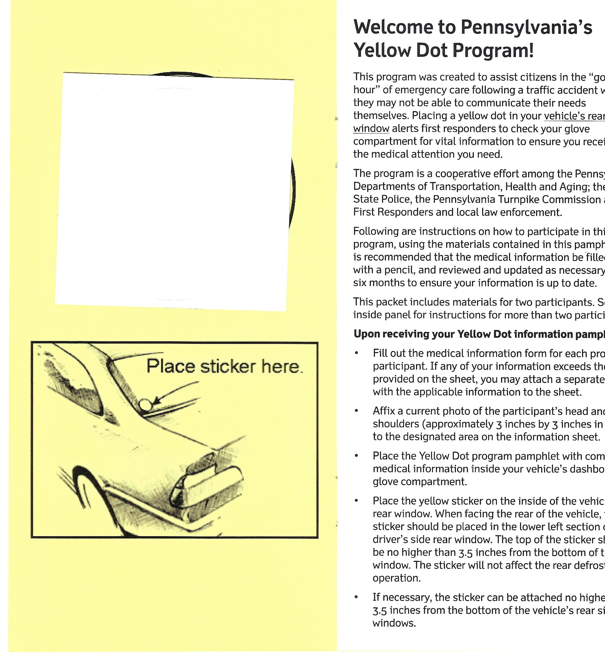
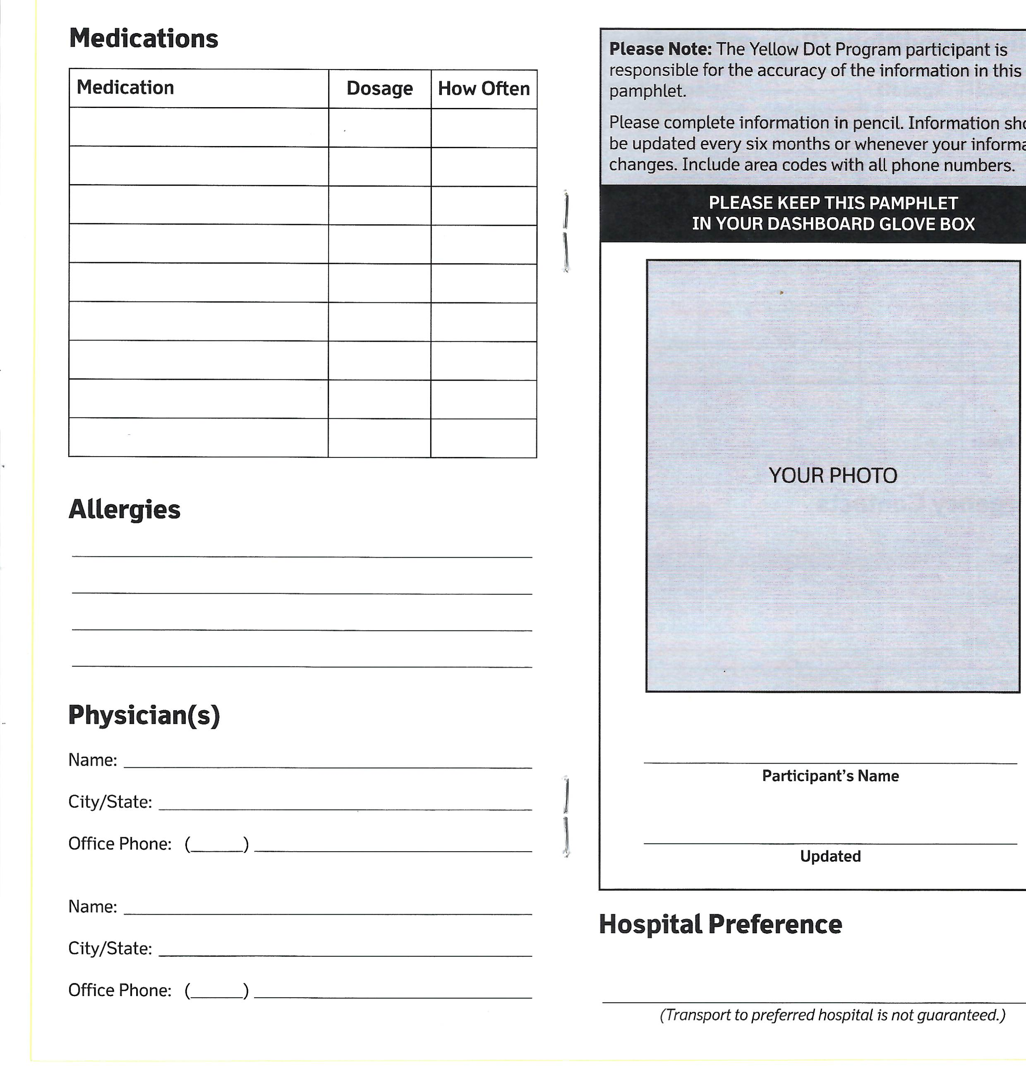
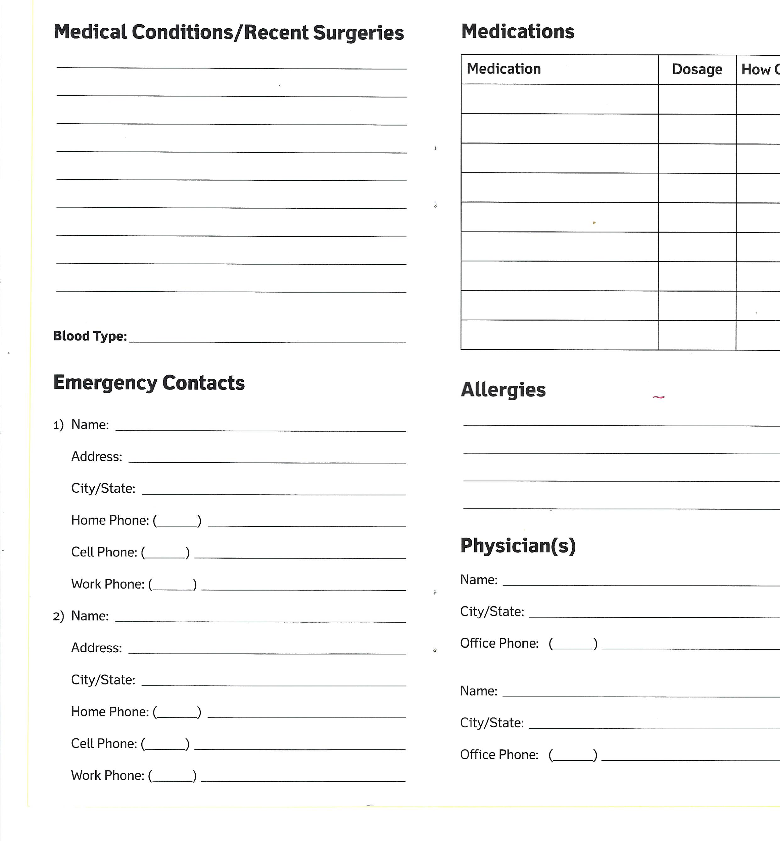
PA Yellow Dot Program

Slide 17
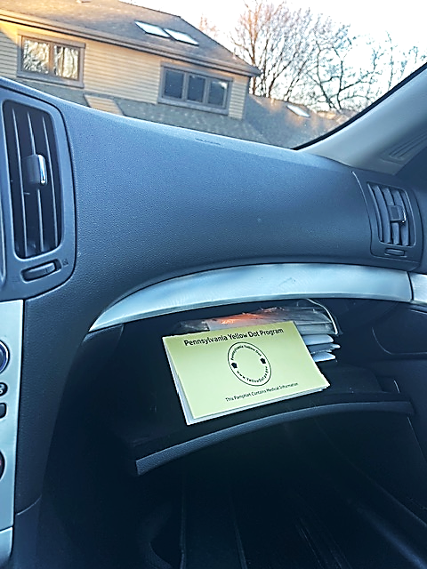
PA Yellow Dot Program

Slide 18
Topic Three
Personal Logistics
Medical ID on Smartphone

Slide 19
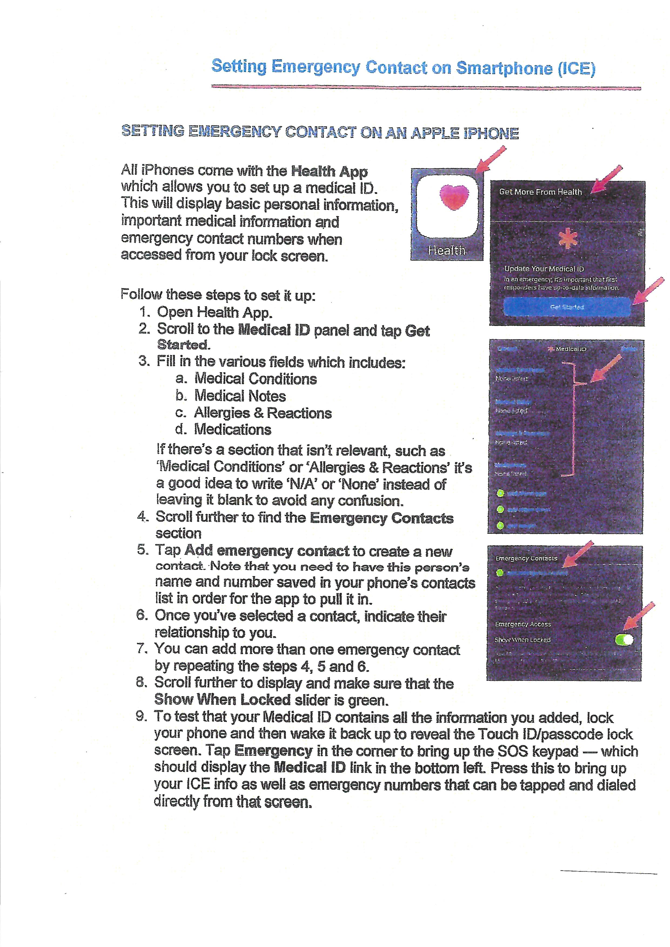
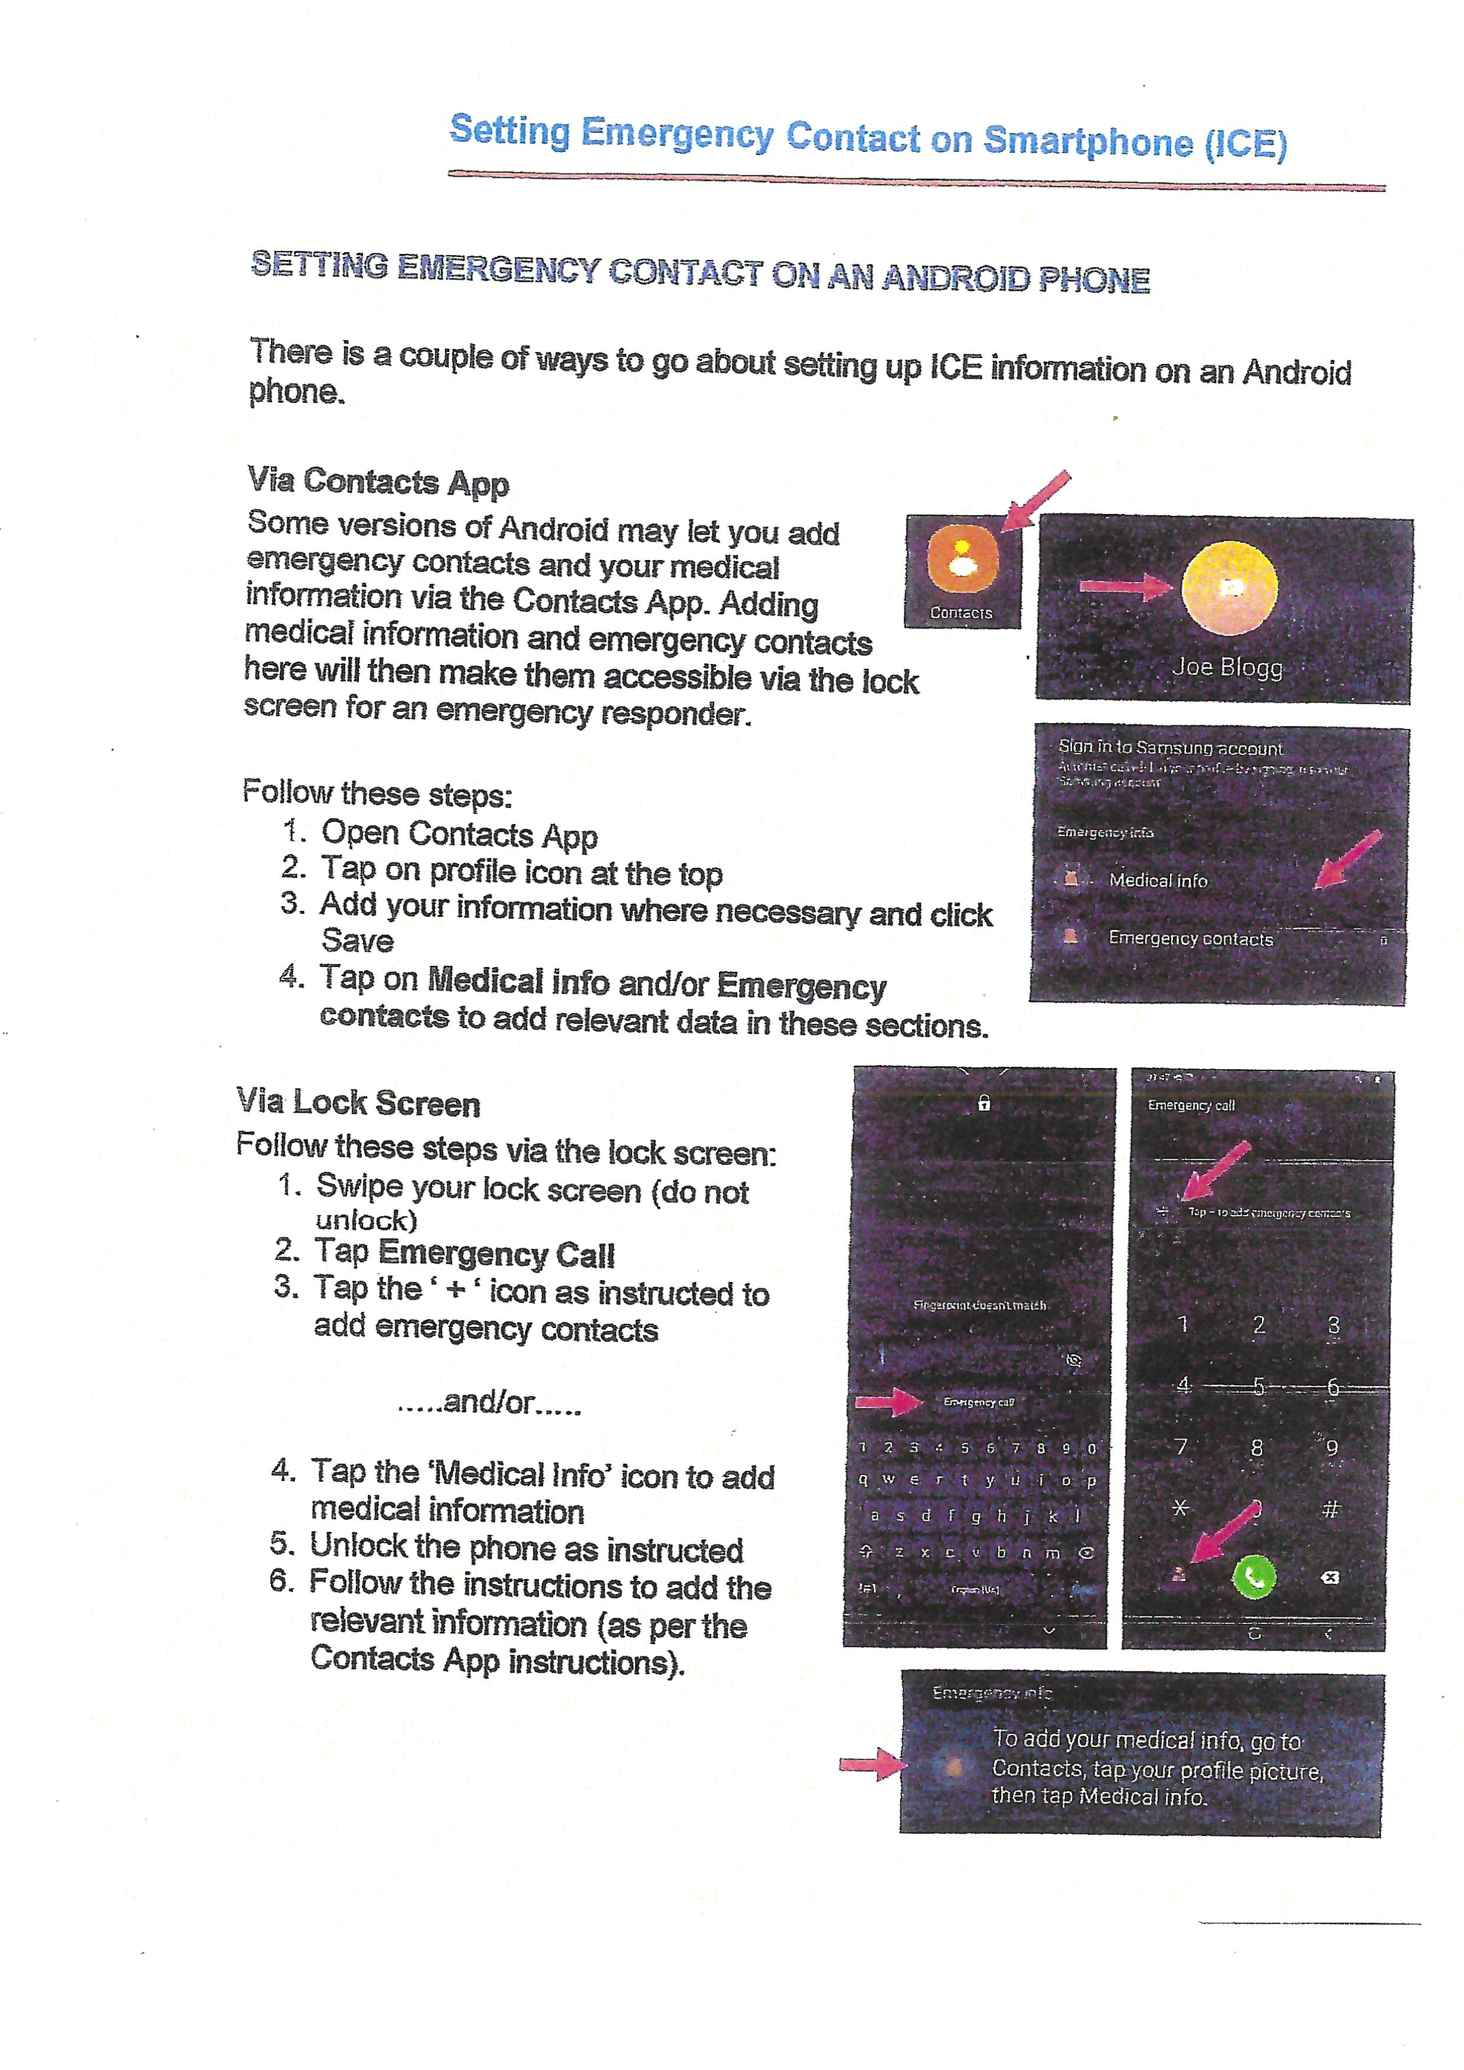
Setting Emergency Contacts on Your Phone 2-sided form
Apple
Android

Slide 20
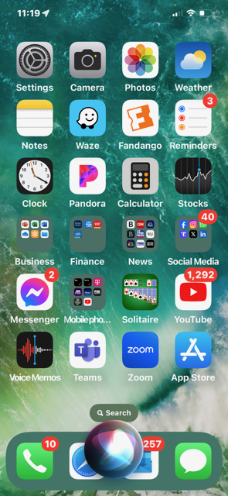
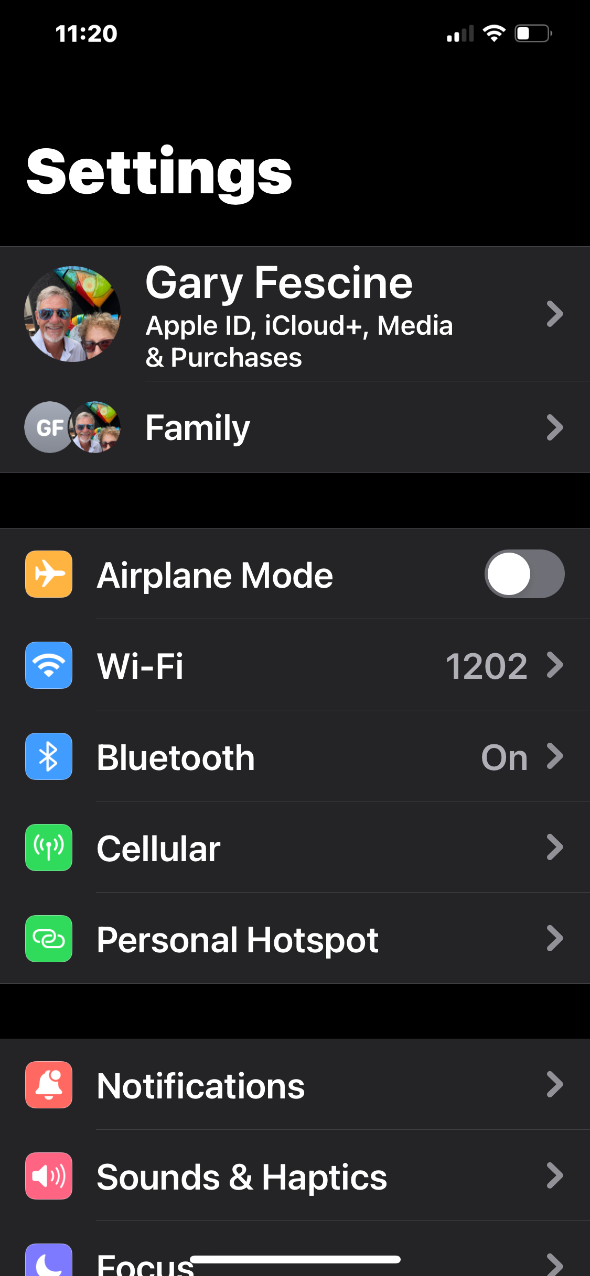
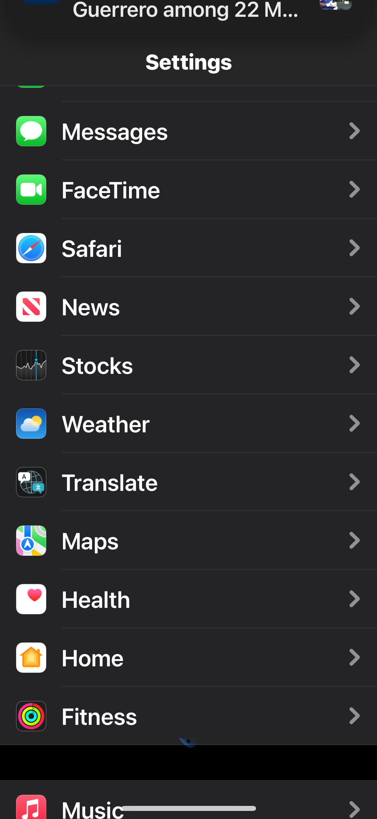
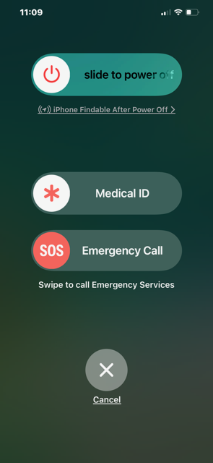

Slide 21
Topic Four
Home, Auto or Personal Logistics
POLST Forms

Slide 22
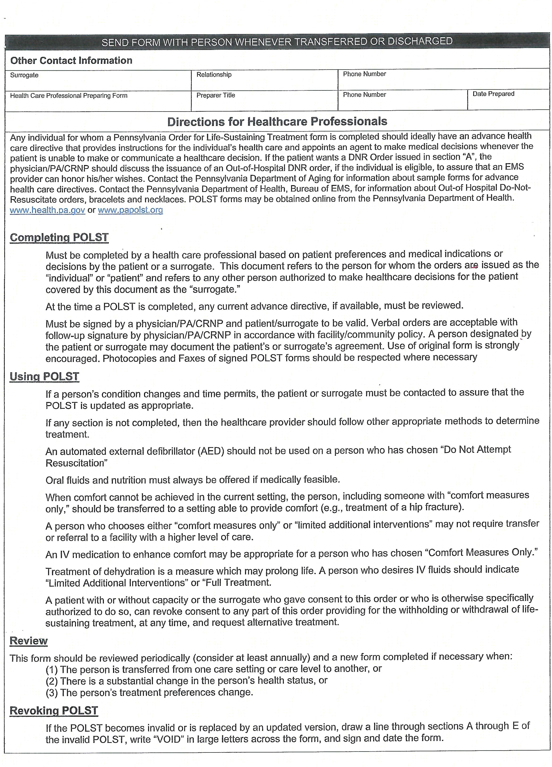
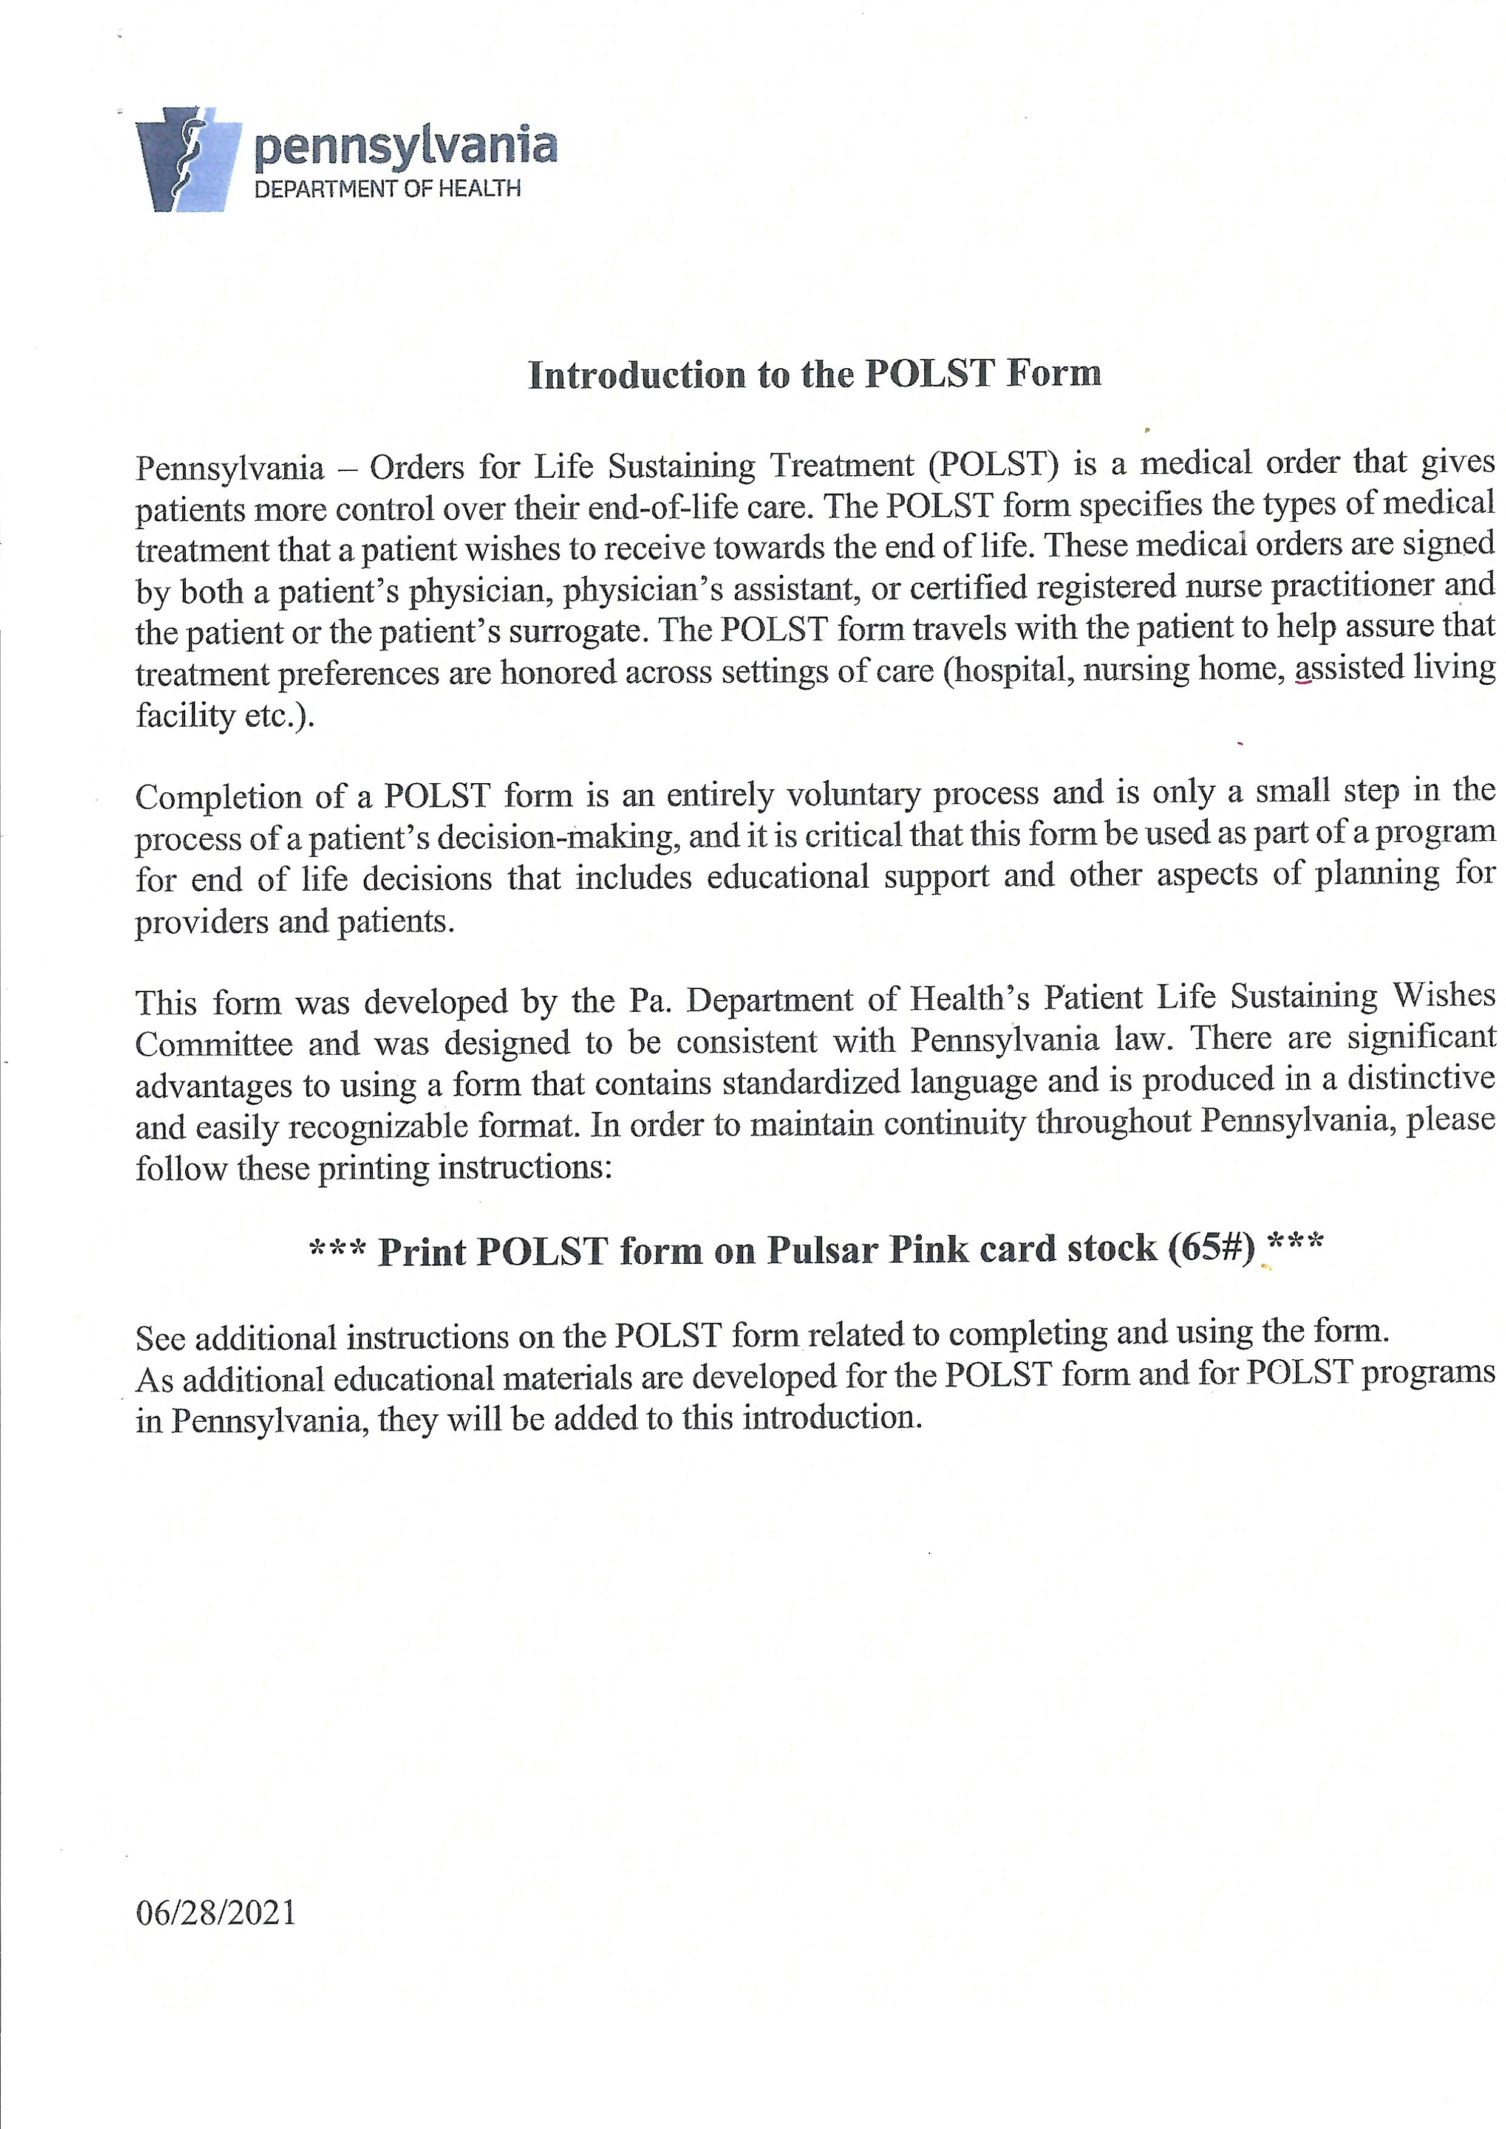
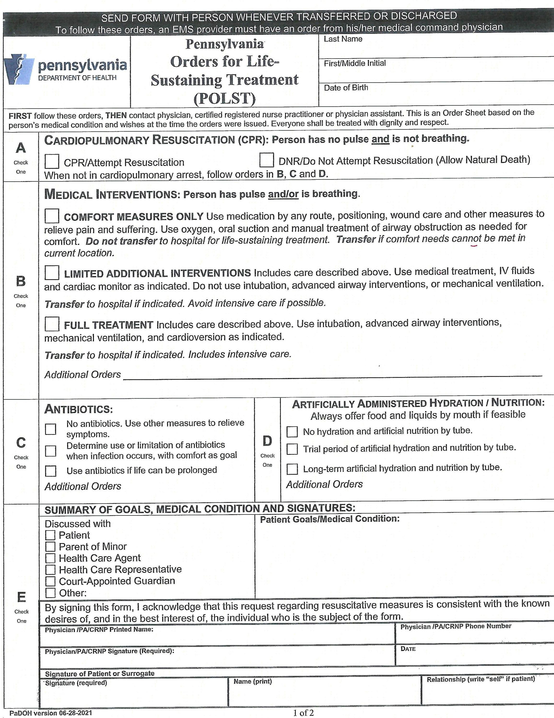
POLST Form (PA Orders for Life-Sustaining Treatment)

Slide 23
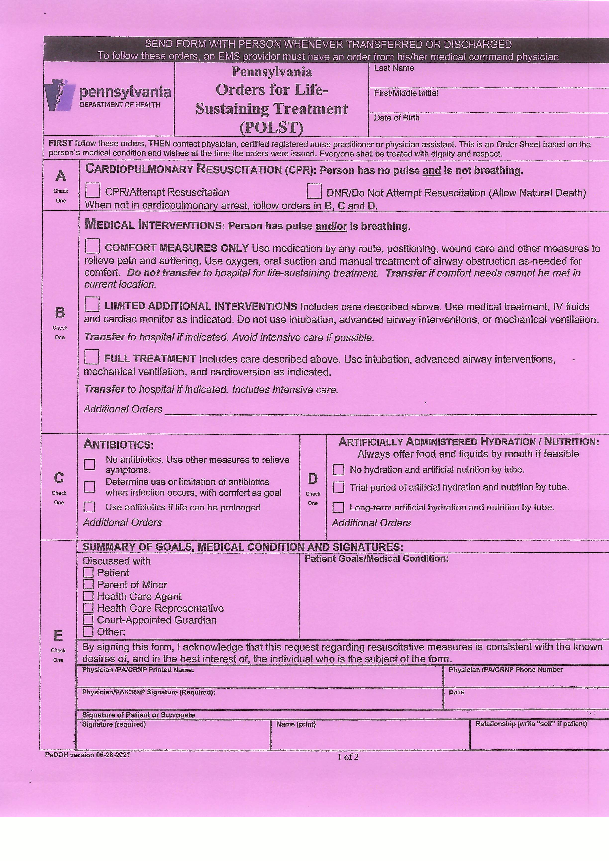
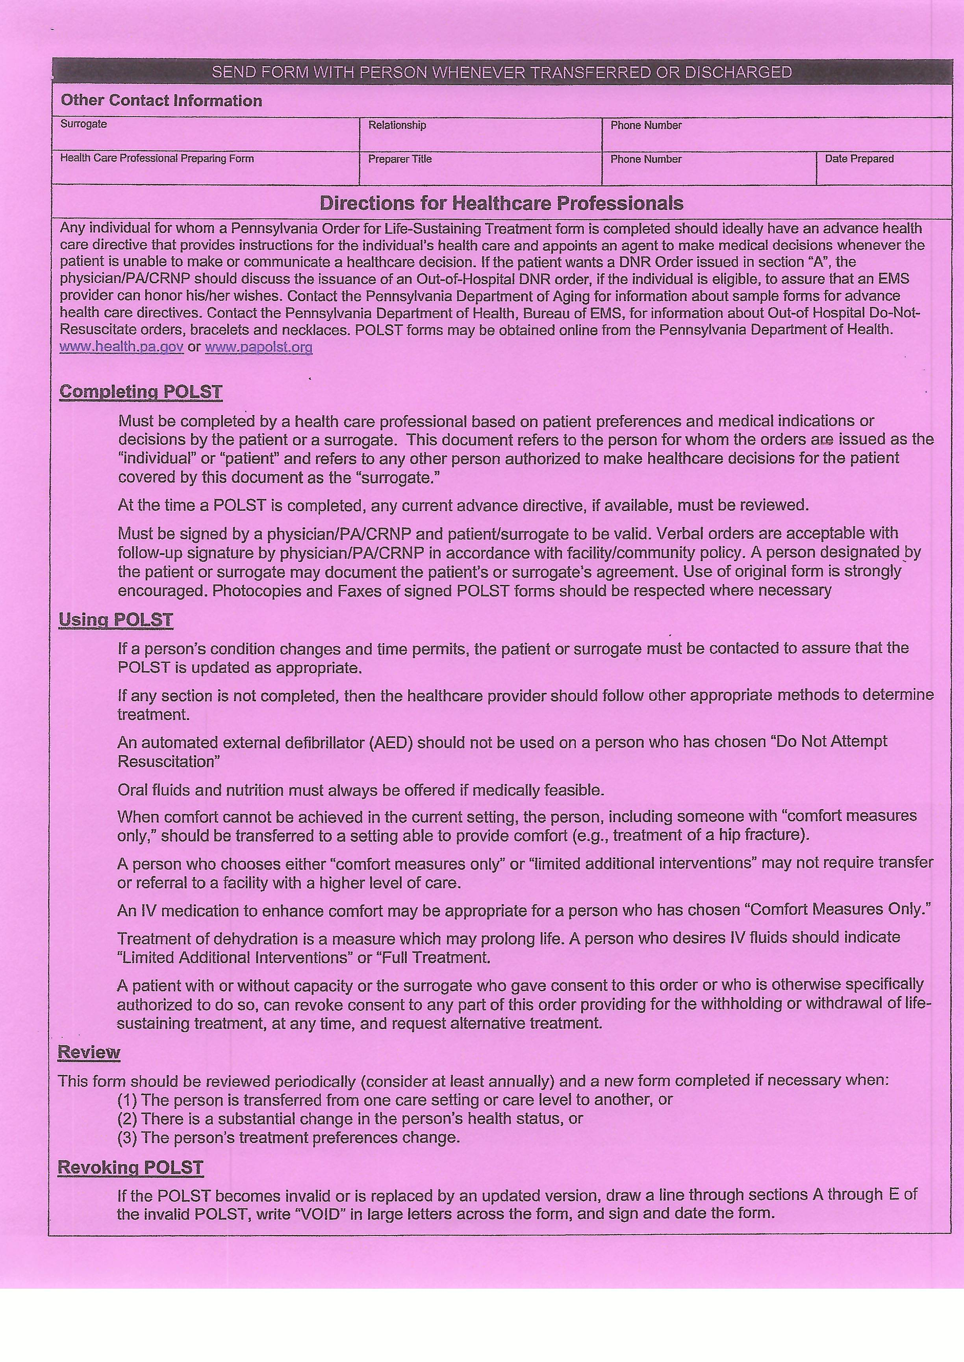
POLST Form (PA Orders for Life-Sustaining Treatment)

Slide 24
MacElree Harvey
Timothy E. Horn, Esquire

Slide 25
Living Will & Durable Health Care Power of Attorney (DHCPOA) vs. POLST
Characteristics | Living Will/DHCPOA | POLST
Type of Document | Legal document; terms typically vary by document | Medical order; standardized by state
Intended Population | All competent adults (18+) | For people with serious, advanced illness or frailty—at any age
Prepared by whom? | The individual, generally with the assistance of an attorney | Healthcare provider in consultation with individual/health care agent/guardian

Slide 26
Living Will & Durable Health Care Power of Attorney (DHCPOA) vs. POLST
Characteristics | Living Will/DHCPOA | POLST
Medical Treatment Communication | Expresses general wishes/preferences about medical treatments an individual does/does not want; hypothetical; geared towards future care | Identifies specific medical treatments an individual does/does not want, based upon the individual’s current state of health
Can emergency responders use it? | Not a medical order; thus, not actionable by emergency personnel | Actionable by emergency personnel
Appointment of Decision-maker | Names a health care agent to speak on the individual’s behalf | Not applicable
When does it become effective? | Only when patient becomes incapacitated. Requires physician to declare lack of capacity. | Immediately

Slide 27
Questions
afc Urgent Care
The Yellow Form
Yellow Dot Program
Mobile Phones
Legal/POLST forms
HM Security

Slide 28
“The way to get started is to quit talking and begin doing.”
Walt Disney

Slide 29
Summary
We envision that the completed single-page medical form for each household resident and if desired the POLST form for each household resident, should go into the white envelope with the yellow dot, attached by a magnetic clamp to your refrigerator.
There is 1 yellow cardboard kit for each automobile. Two per household. Yellow dot on the back window, driver’s side and medical forms in the glove box.
Personal smartphones are designed to allow first responders to access your Medical ID without a password. This will provide vital relevant medical information to a first responder wherever you might need help. You must set it up though!

Slide 30
Thank you
Princeton Village
Michael Kallay, MD
Gary Fescine

